Slide 1
CS312 Artificial Intelligence
Lecture # 03
HITEC University, Taxila
Mr. Mubashir Iqbal
Fall-2025

Slide 2
Data Structures
An overview lecture of Data-Structures, Mainly focused on Tree and Graph data-structures. These topics/concepts are required for better understanding of next Lectures.

Slide 3
Data Structures
A data structure is a way of collecting and organizing data in such a way that we can perform operations on the data effectively.
Operations like:
Insertion (Add a new element to the data structure)
Deletion (Remove an element from the structure)
Traversal (Visit each element (typically for display or processing))
Searching (Find a particular value or element)
Sorting (Arrange data in a specific order)
Access (Retrieve data at a specific location)
Updating (Modify existing data values)

Slide 4
Why Data Structures Matter
Efficient Problem Solving: Choosing the right data structure makes solving complex problems easier and faster.
Performance Optimization: Impacts time and space complexity. Data defines the speed, memory, and accuracy of computation. critical for building scalable systems.
Code Readability and Maintainability: Using appropriate data structures makes the code cleaner, more natural, and easier to debug or extend.
Foundation for Algorithms: Many algorithms are built on top of specific data structures.
Notes:
Think of data structures as the skeleton of every software system. Without the right structure, even the best algorithm fails to perform efficiently.

Slide 5
Time Complexity
Time Complexity measures how much time an algorithm takes to complete as the input size increases.
It is expressed as a mathematical function of the input size (n). It helps us compare algorithms based on their efficiency — how fast they solve a problem.
Simple Explanation
Time complexity tells us how the running time of an algorithm grows when we give it more data to process.
For example:
Sorting 10 numbers takes 1 second.
Sorting 1,000 numbers might take 100 seconds. The rate of increase in time shows the time complexity.

Slide 6
Time Complexity
Why It Matters
Helps developers predict performance before running the code.
Important for optimization in AI, data science, and cybersecurity applications.
Allows fair comparison between different algorithms (e.g., BFS vs DFS).
Algorithm | Time Complexity | Description
BFS | O(V + E) | Visits each vertex and edge once
DFS | O(V + E) | Same as BFS, but different traversal order
Uniform Cost Search | O(E + V log V) | Uses priority queue (depends on cost)
A* | O(b^d) worst-case | Depends on branching factor and depth

Slide 7
Space Complexity
Space Complexity measures the total amount of memory an algorithm needs to execute completely.
It includes all memory used for:
Input data
Variables and constants
Temporary data structures (like queues, stacks, recursion memory)
Function call overhead
Simple Explanation: Space Complexity tells us how much memory (RAM) an algorithm needs as the input size grows.
Example:
A simple addition program that adds two numbers → needs constant memory (O(1)).
BFS algorithm → needs large memory to store all visited nodes in a queue.

Slide 8
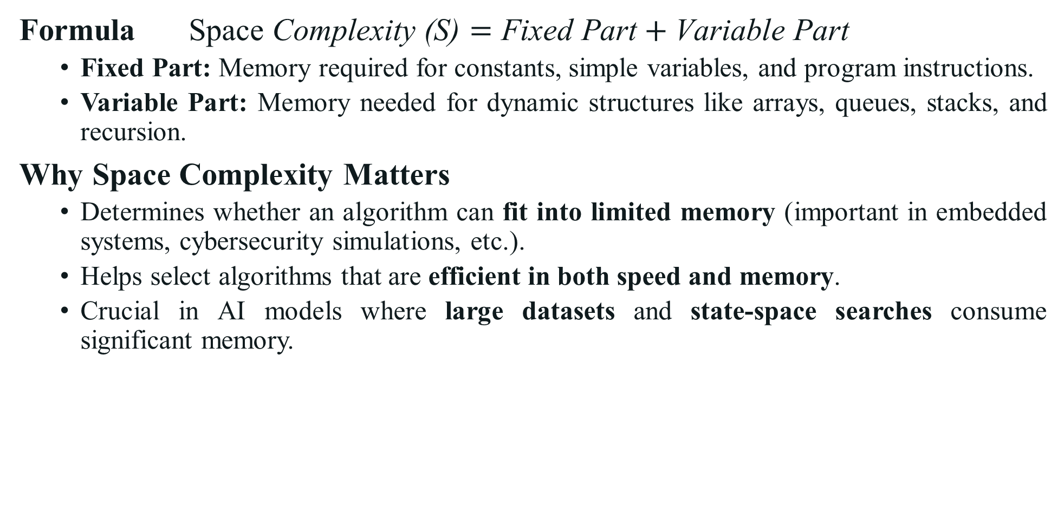
Space Complexity
Formula $\text{Space} \text{Complexity}\text{ (}\text{S}\text{)}=\text{Fixed} \text{Part}+\text{Variable} \text{Part}$
Fixed Part: Memory required for constants, simple variables, and program instructions.
Variable Part: Memory needed for dynamic structures like arrays, queues, stacks, and recursion.
Why Space Complexity Matters
Determines whether an algorithm can fit into limited memory (important in embedded systems, cybersecurity simulations, etc.).
Helps select algorithms that are efficient in both speed and memory.
Crucial in AI models where large datasets and state-space searches consume significant memory.
Algorithm | Space Complexity | Reason
BFS | O(bᵈ) | Must store all nodes at each level (uses a queue).
DFS | O(b·m) | Stores only the path + unexpanded nodes (uses a stack/recursion).
Uniform Cost Search | O(bᵈ) | Stores frontier nodes in a priority queue.
A* | O(bᵈ) | Keeps all nodes in memory for path-cost comparison.

Slide 9
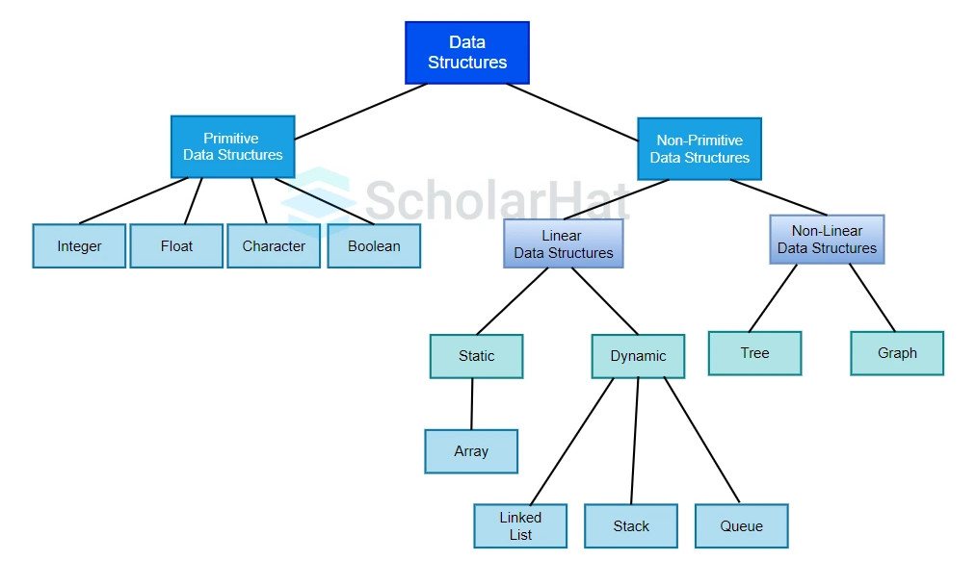
Types of Data Structures

Slide 10
Primitive Data Structures
Primitive data structures are the most basic units of data that serve as the building blocks for all other data structures. They directly operate upon the machine instructions and are provided by programming languages natively.
S/N | Structures | Purpose | Size & Range (architecture-dependent)
1 | Integer (int) | Represents whole numbers (no decimal point) | 16-bit: -32,768 to 32,767 32-bit: -2,147,483,648 to 2,147,483,647 64-bit: −9,223,372,036,854,775,808 to 9,223,372,036,854,775,807
2 | Float / Double | Represents real numbers (decimals) | Float (32-bit): Precision: ~7 decimal digits Double (64-bit): Precision: ~15 decimal digits
3 | Character (char) | Stores a single alphanumeric character | ASCII: 0 to 127 Extended ASCII: 0 to 255 Unicode (UTF-16): 0 to 65,535 (used in Java, Python)
4 | Boolean (bool) | Holds one of two possible values: True or False | Often 1 byte (even though 1 bit is sufficient)

Slide 11
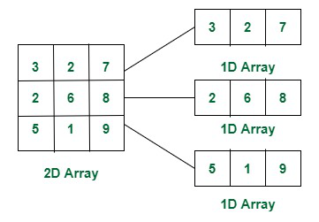
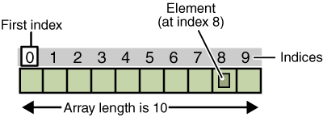
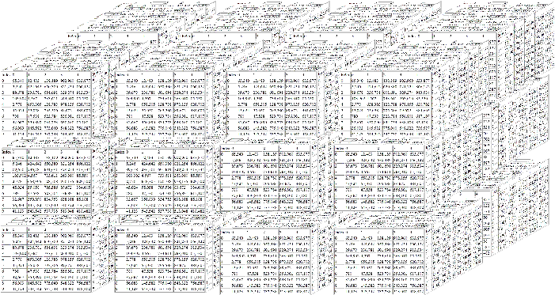
Non-Primitive Data Structures (Linear)
1. Arrays
An Array is a linear data structure that stores a fixed-size sequence of elements of the same data type in contiguous memory locations.
Types:
1D – Single Dimensional
2D – Double Dimensional
3D – Three Dimensional
ND – N time Dimensional

Slide 12
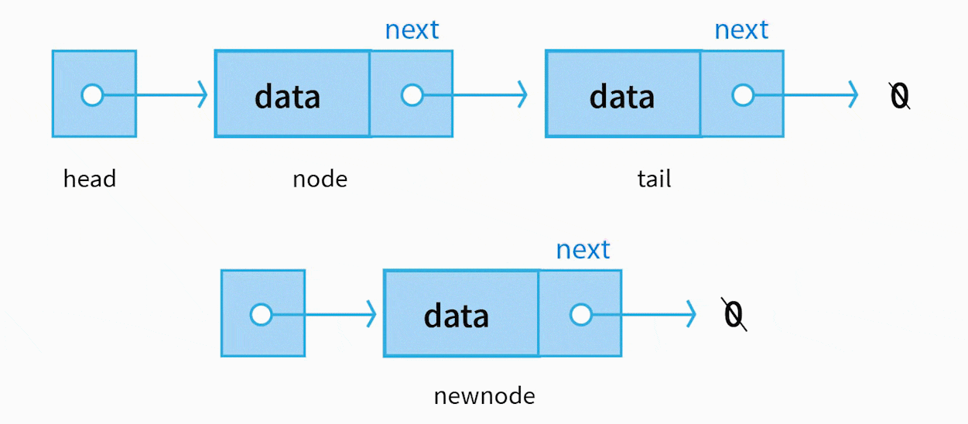
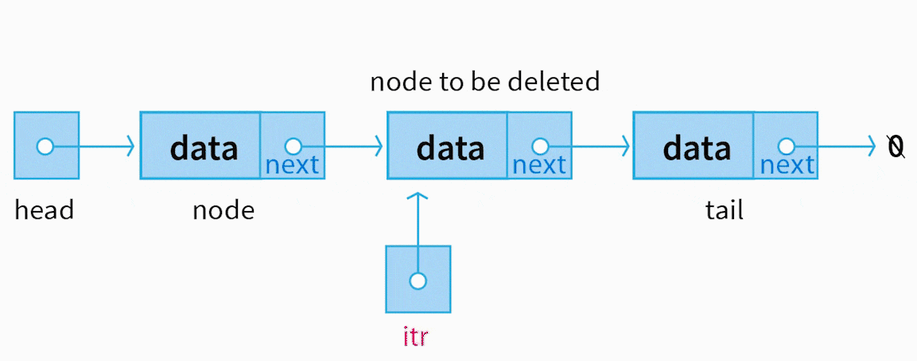
Non-Primitive Data Structures (Linear)
2. Lists: A List is a linear data structure that stores a collection of elements in a sequence, where order matters. Each element can be accessed by its position (index), duplicates are allowed, dynamic resizing, and efficient insertions/deletions.
Each element (node) contains data + pointer
struct Node {
int data;
struct Node* next;
};

Slide 13
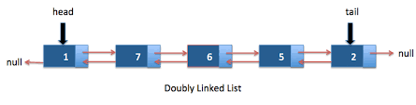
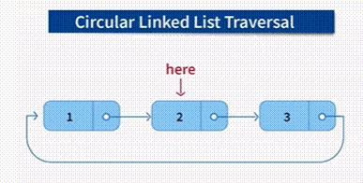
Non-Primitive Data Structures (Linear)
2. Lists
Types:
Singly Linked List
Doubly Linked List
Circular Linked List
Double circular Linked List

Slide 14
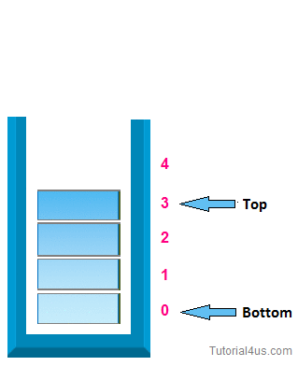
Non-Primitive Data Structures (Linear)
3. Stack
A Stack is a linear data structure that follows the LIFO (Last In, First Out) principle.
Operations:
push(x) Adds element x to the top of the stack
pop() Removes the top element from the stack
peek() or top() Views the top element without removing it
isEmpty() Checks if the stack is empty
Notes:
1. Function Call Stack (Recursion)
function call is pushed onto the call stack.
When the function finishes, it's popped off.
2. Undo/Redo Functionality
Used in editors like MS Word, Photoshop.
Each action is pushed onto a stack.
Pressing Undo pops the last action.
3. Backtracking (e.g., Maze Solving, DFS)
Stacks are used to track the path.
4. Expression Evaluation & Syntax Parsing
Compilers use stacks for:
Infix to postfix conversion
5. Stack of Plates / Books
Last plate/book added is the first to be removed.
6. Browser History (Back Button)
Each visited page is pushed onto a stack.
Pressing "Back" pops the current page and shows the previous.
7. Reversing a Word
Push each character onto a stack, then pop to reverse the string.
8. Boxing Items
Items are packed in boxes, last item packed is first to unpack.

Slide 15
Non-Primitive Data Structures (Linear)
3. Stack
1. Undo/Redo Functionality: Used in editors like MS Word, Photoshop, Each action is pushed onto a stack, Pressing Undo pops the last action.
2. Backtracking (e.g., Maze Solving, DFS), Stacks are used to track the path.
3. Expression Evaluation & Syntax Parsing: Compilers use stacks for: Infix to postfix conversion
4. Stack of Plates / Books: Last plate/book added is the first to be removed.
5. Browser History (Back Button): Each visited page is pushed onto a stack, Pressing "Back" pops the current page and shows the previous.
6. Reversing a Word: Push each character onto a stack, then pop to reverse the string.
7. Boxing Items: Items are packed in boxes, last item packed is first to unpack.
Notes:
1. Function Call Stack (Recursion)
function call is pushed onto the call stack.
When the function finishes, it's popped off.
2. Undo/Redo Functionality
Used in editors like MS Word, Photoshop.
Each action is pushed onto a stack.
Pressing Undo pops the last action.
3. Backtracking (e.g., Maze Solving, DFS)
Stacks are used to track the path.
4. Expression Evaluation & Syntax Parsing
Compilers use stacks for:
Infix to postfix conversion
5. Stack of Plates / Books
Last plate/book added is the first to be removed.
6. Browser History (Back Button)
Each visited page is pushed onto a stack.
Pressing "Back" pops the current page and shows the previous.
7. Reversing a Word
Push each character onto a stack, then pop to reverse the string.
8. Boxing Items
Items are packed in boxes, last item packed is first to unpack.

Slide 16
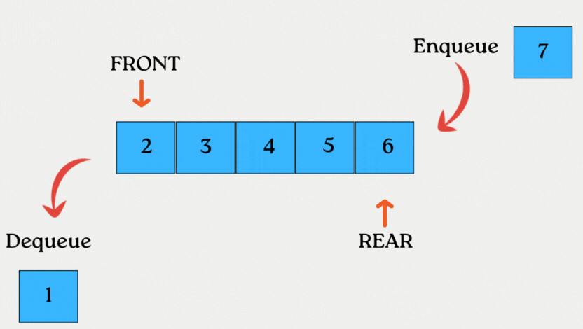
Non-Primitive Data Structures (Linear)
4. Queues
A Queue is a linear data structure that follows the FIFO (First In, First Out) principle.
Operations:
enqueue(x) Adds element x at the rear
dequeue() Removes and returns element from front
front() Returns element at the front (without removing it)
isEmpty() Checks if the queue is empty
Notes:
Type:
1. Simple Queue Standard FIFO queue
2. Circular Queue Last position connects to the first to reuse space
3. Priority Queue Elements dequeued based on priority, not just order
4. Double-Ended Queue: Insertions and deletions from both front and rear
Applications of Queue:
CPU & Disk Scheduling
Tasks are processed in the order they arrive.
Print Queue
Documents sent to the printer are queued in order.
Breadth-First Search (BFS)
Used in graph/tree traversal algorithms.
Data Buffering
Queues handle streaming data or I/O buffers.
Network Routing
Packets are handled in the order they arrive.

Slide 17
Non-Primitive Data Structures (Linear)
Type of Queues :
1. Simple Queue Standard FIFO queue
2. Circular Queue Last position connects to the first to reuse space
3. Priority Queue Elements dequeued based on priority, not just order
4. Double-Ended Queue: Insertions and deletions from both front and rear
Notes:
Applications of Queue:
CPU & Disk Scheduling
Tasks are processed in the order they arrive.
Print Queue
Documents sent to the printer are queued in order.
Breadth-First Search (BFS)
Used in graph/tree traversal algorithms.
Data Buffering
Queues handle streaming data or I/O buffers.
Network Routing
Packets are handled in the order they arrive.

Slide 18
Non-Primitive Data Structures (Linear)
Applications of Queue:
CPU & Disk Scheduling
Tasks are processed in the order they arrive.
Print Queue
Documents sent to the printer are queued in order.
Breadth-First Search (BFS)
Used in graph/tree traversal algorithms.
Data Buffering
Queues handle streaming data or I/O buffers.
Network Routing
Packets are handled in the order they arrive.

Slide 19
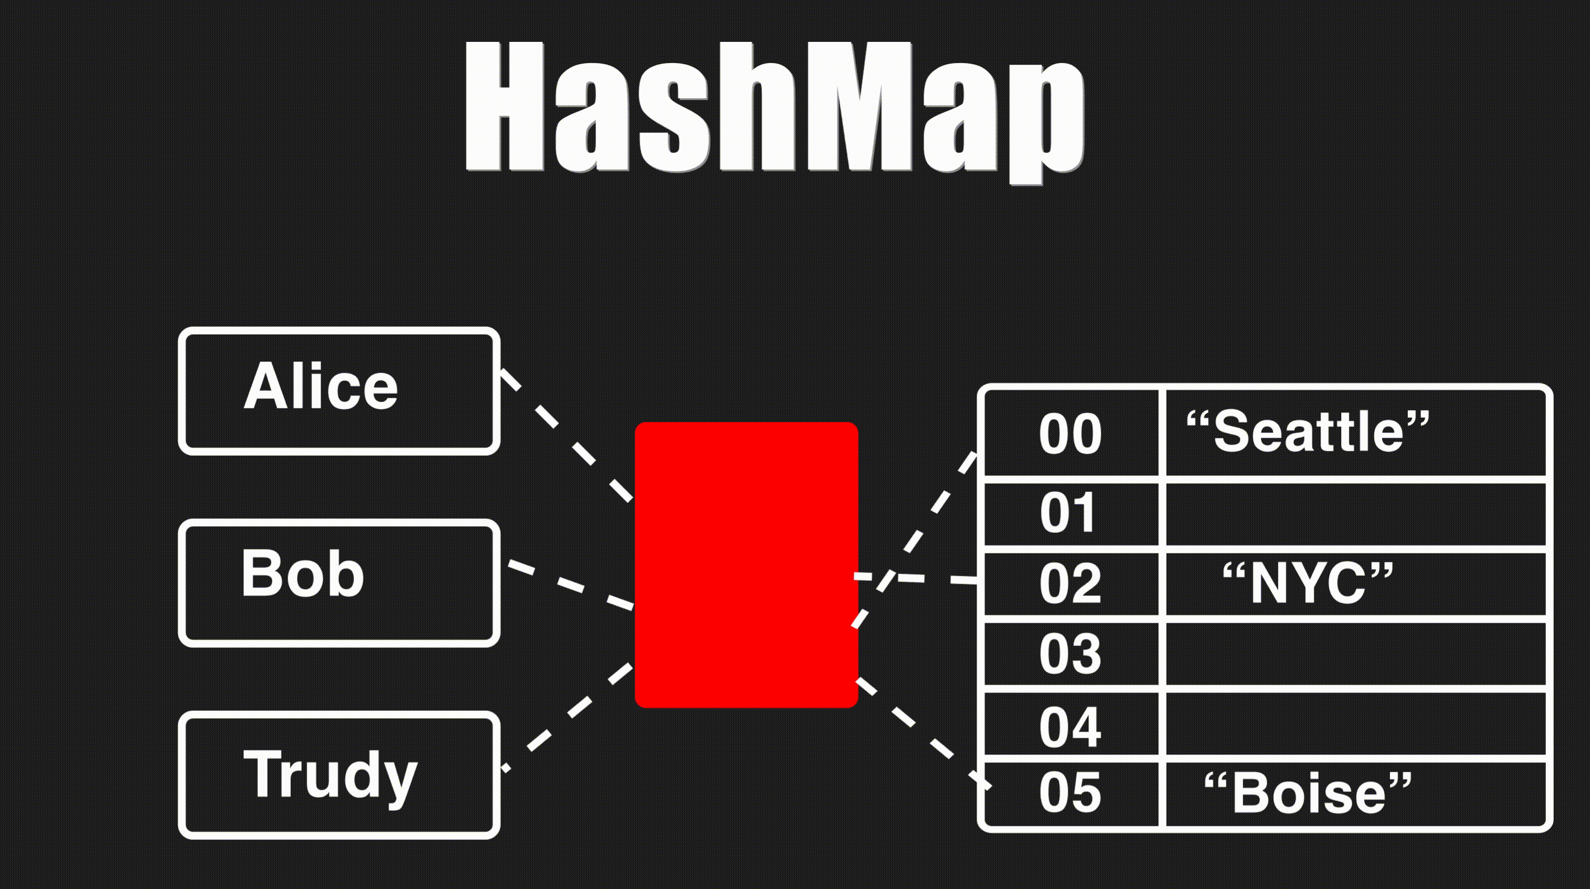
Non-Primitive Data Structures (Non-Linear)
5. Hash Tables
A Hash Table (also called a Hash Map) is a data structure that stores key-value pairs and provides fast data access using a hashing function.
Operations:
insert(key, value) Stores value with the key
averagesearch(key) Retrieves value by key
averagedelete(key) Removes key-value pair
Notes:
Components:
Key: The identifier used to store or retrieve the value.
Value: The actual data associated with the key.
Hash Function: Converts the key into a numeric index.
Bucket: The slot in the underlying array where the value is stored.
Applications of Hash Tables
Database Indexing
Quick lookup of records using unique keys (like IDs).
Symbol Table in Compilers
Maps variable/function names to information like type, scope, etc.
Caching / Memoization
Store precomputed results for fast future retrieval.
Sets and Maps in Programming
Most programming languages implement dictionaries and sets using hash tables.
Password Verification
Store password hashes instead of raw passwords.

Slide 20
Non-Primitive Data Structures (Non-Linear)
Components:
Key: The identifier used to store or retrieve the value.
Value: The actual data associated with the key.
Hash Function: Converts the key into a numeric index.
Bucket: The slot in the underlying array where the value is stored.
Applications of Hash Tables
Database Indexing: Quick lookup of records using unique keys (like IDs).
Symbol Table in Compilers: Maps variable/function names to information like type, scope, etc.
Caching / Memoization: Store precomputed results for fast future retrieval.
Sets and Maps in Programming: Most programming languages implement dictionaries and sets using hash tables.
Password Verification: Store password hashes instead of raw passwords.

Slide 21
Non-Primitive Data Structures (Non-Linear) 6. Trees

Slide 22
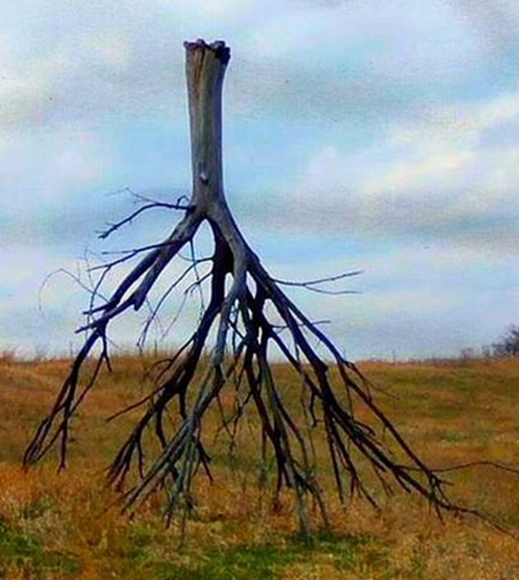
Non-Primitive Data Structures (Non-Linear)
6. Trees
A tree is a special type of data structure that organizes data in a hierarchical format. It starts with a single node called the root, and branches out into child nodes. Each node can have zero or more children, but only one parent (except the root, which has none).
Think of it like:
A family tree:
grandparents → parents → children.
A folder system:
root folder → subfolders → files.

Slide 23
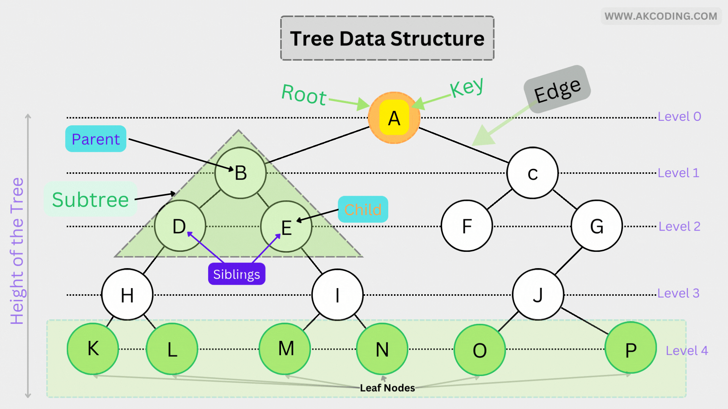
Non-Primitive Data Structures (Non-Linear)
6. Trees
Key Terms (Simplified)
Root: The topmost node (starting point).
Parent: A node that has children.
Child: A node that comes from a parent.
Leaf: A node with no children.
Subtree: A smaller tree within the main tree.

Slide 24
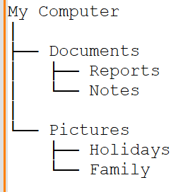
Non-Primitive Data Structures (Non-Linear)
6. Trees
Real-Life Examples in Computer Science
Here are some daily-use operations and systems where trees are essential:
1. Operating Systems
- File Explorer: Your computer’s folders and files are stored in a tree structure.
- Example: C:\ → Documents → Projects → Proposal.docx
2. Web Development
- HTML/XML Documents: Tags are nested like a tree.
- <html> is the root, with <head> and <body> as children.
3. Databases
- Indexing: Trees like B-Trees or Binary Search Trees help databases quickly find and sort data.
4. Artificial Intelligence
- Decision Trees: Used in machine learning to make predictions.
- Example: Should we approve a loan? → Income > 50K → Yes.

Slide 25
Non-Primitive Data Structures (Non-Linear)
6. Trees
5. Compilers
- Syntax Trees: Used to understand and compile code.
- Example: a + b * c becomes a tree to determine operation order.
6. Networking
- Routing Tables: Use tree structures to find the best path for data packets.
7. Games
- Game Trees: Used to simulate possible moves and outcomes.
- Example: Chess AI explores moves using a tree.

Slide 26
Non-Primitive Data Structures (Non-Linear)
6. Trees
Common Types of Trees:
Binary Tree – Each node has up to 2 children.
Binary Search Tree (BST) – Data is organized so that left < parent < right.
Balanced Binary Tree
AVL Tree – A self-balancing BST.
Heap Tree – Used for priority queues.
Trie – Used for storing words (like in autocomplete).

Slide 27
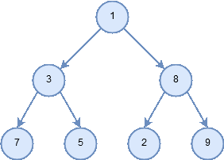
Non-Primitive Data Structures (Non-Linear)
6. Trees
6.1 Binary Tree
Imagine a family tree where each person can have up to two children. That’s a binary tree.
Each node contains:
A value (like a name or number)
A left link to another node (or nothing)
A right link to another node (or nothing)
Binary trees are used to:
Organize data for fast searching and sorting
Model hierarchical relationships
Build efficient algorithms for decision-making, parsing, and more

Slide 28
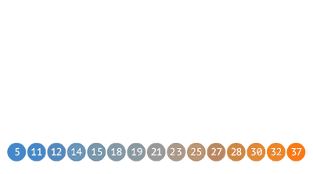
Non-Primitive Data Structures (Non-Linear)
6. Trees
6.2 Binary Search Tree
A Binary Search Tree (BST) is a type of binary tree that follows a specific ordering rule:
Left Subtree: Contains nodes with values less than the parent node.
Right Subtree: Contains nodes with values greater than the parent node.
This rule applies recursively to every node in the tree.
This structure allows for efficient searching, insertion, and deletion — especially when the tree remains balanced.

Slide 29
Non-Primitive Data Structures (Non-Linear)
6. Trees
6.2 Binary Search Tree
Common Operations
Search: Quickly find a value by traversing left/right.
Insert: Place a new value in the correct position.
Traversal: Used to access data in a sorted order.
Delete: Remove a node and restructure the tree
Find Minimum / Maximum: Finds the smallest or largest value in the tree
Height / Depth: Measures how “tall” the tree is (how many levels it has).

Slide 30
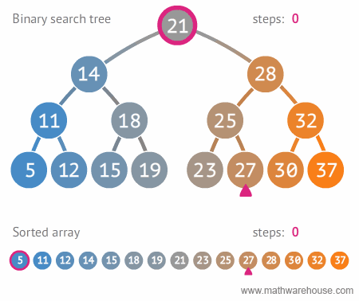
Non-Primitive Data Structures (Non-Linear)
6. Trees
6.2 Binary Search Tree
Common Operations
1. Search: Quickly find a value by traversing left/right.
How it works:
Start from the root → if value < root, move left → if value > root, move right → stop when found or reach a null node.
Example: Search for 27. If 27 exists, it tells the position; otherwise, says “not found.”

Slide 31

Non-Primitive Data Structures (Non-Linear)
6. Trees
6.2 Binary Search Tree
Common Operations
2. Insert: Place a new value in the correct position.
How it works:
Start from the root
→ compare the new value
→if it’s smaller, go left; if greater, go right
→ repeat until an empty spot is found.

Slide 32
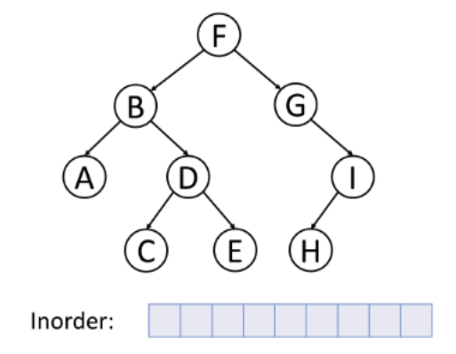
Non-Primitive Data Structures (Non-Linear)
6. Trees
6.2 Binary Search Tree
Common Operations
3. Traversal: Visits all nodes of the tree in a certain order.
Main types:
Inorder (Left → Root → Right): Gives values in sorted order.
Preorder (Root → Left → Right): Used to copy or print structure.
Postorder (Left → Right → Root): Used to delete all nodes safely.
Example: Inorder traversal of the tree gives sorted data like 10, 20, 30, 40, 50.

Slide 33
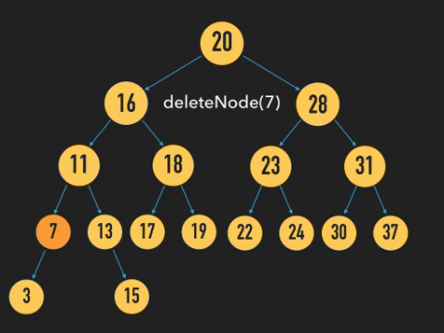
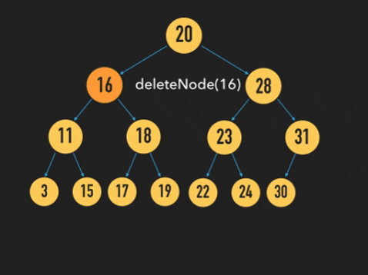
Non-Primitive Data Structures (Non-Linear)
6. Trees
6.2 Binary Search Tree
Common Operations
4. Delete: Remove a node and restructure the tree
How it works:
There are 3 cases:
No child → just delete it.
One child → replace it with its child.
Two children → replace it with its inorder successor (smallest value in right subtree).

Slide 34
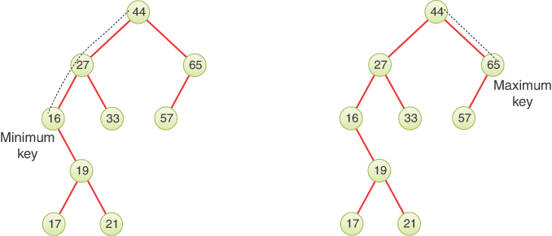
Non-Primitive Data Structures (Non-Linear)
6. Trees
6.2 Binary Search Tree
Common Operations
5. Find Minimum / Maximum
Finds the smallest or largest value in the tree.
How it works:
Minimum: Keep moving left until you can’t.
Maximum: Keep moving right until you can’t.
Example: In BST, the leftmost node is the smallest number.

Slide 35
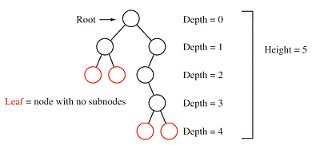
Non-Primitive Data Structures (Non-Linear)
6. Trees
6.2 Binary Search Tree
Common Operations
6. Height / Depth
Measures how “tall” the tree is (how many levels it has).
Why it’s useful:
Helps check if the tree is balanced — a balanced tree is faster to search..

Slide 36
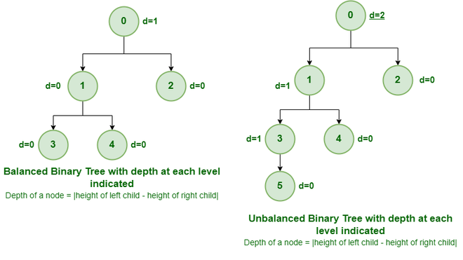
Non-Primitive Data Structures (Non-Linear)
6. Trees
6.3 Balanced Binary Tree
A Balanced Binary Tree is a special type of binary tree where the height of the left and right subtrees of every node differs by at most 1.
In simple words — it’s a binary tree that stays evenly distributed so that no side (left or right) grows much deeper than the other.

Slide 37
Non-Primitive Data Structures (Non-Linear)
6. Trees
6.4 AVL Tree
An AVL Tree (named after inventors Adelson-Velsky and Landis) is a type of Binary Search Tree (BST) that automatically keeps itself balanced. In a regular BST, inserting or deleting nodes can make the tree skewed, slowing down operations. AVL Trees fix this by adjusting the structure after every change.
There are four types of rotations:
Left Rotation
Right Rotation
Left-Right Rotation
Right-Left Rotation
These are quick adjustments that keep the tree balanced without affecting the overall data structure integrity.

Slide 38
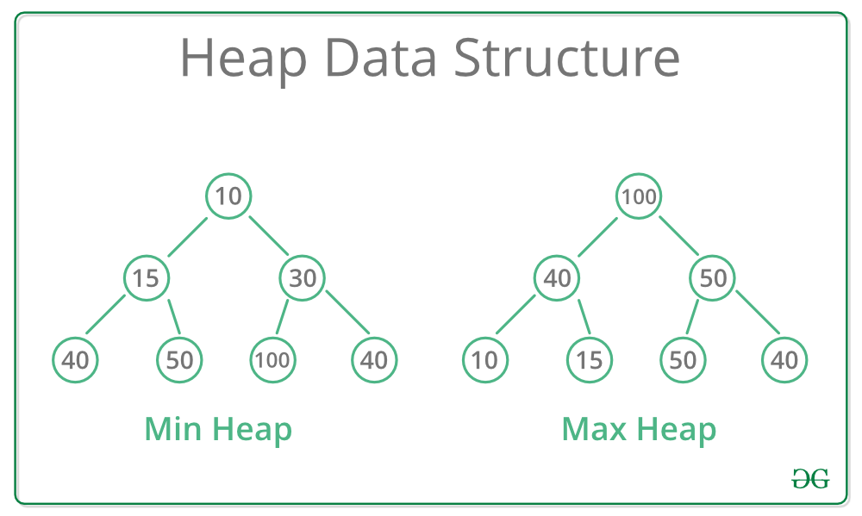
Non-Primitive Data Structures (Non-Linear)
6. Trees
6.5 Heap Tree
A Heap Tree is a complete binary tree (all levels are filled except possibly the last one, which is filled from left to right) that follows a specific heap property.
Types of Heap:
Max Heap:
The parent node has a value greater than or equal to its children.
The largest element is always at the root.
Min Heap:
The parent node has a value smaller than or equal to its children.
The smallest element is always at the root.

Slide 39
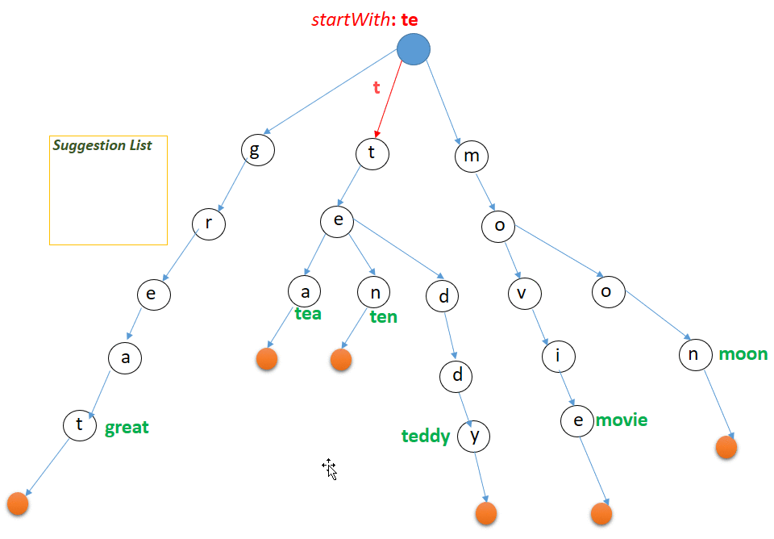
Non-Primitive Data Structures (Non-Linear)
6. Trees
6.6 Trie Tree
A Trie, also called a Prefix Tree, is a special type of tree data structure used to store and search strings efficiently, especially when dealing with prefix-based operations like autocomplete, spell checking, or dictionary word lookups.
Structure:
Each node in a Trie represents a single character of a string.
The path from the root to a node represents a prefix of some word.
The end of a word is marked with a special flag (like isEnd = True).

Slide 40
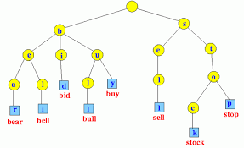
Non-Primitive Data Structures (Non-Linear)
6. Trees
6.6 Trie Tree
Real-Life Applications:
Autocomplete Systems: Suggests words as you type (e.g., Google search bar).
Spell Checkers: Quickly find similar or valid words.
Text Prediction: Mobile keyboard suggestions.
Dictionary Storage: Efficient lookup and prefix matching.

Slide 41
Non-Primitive Data Structures (Non-Linear) 7. Graph

Slide 42
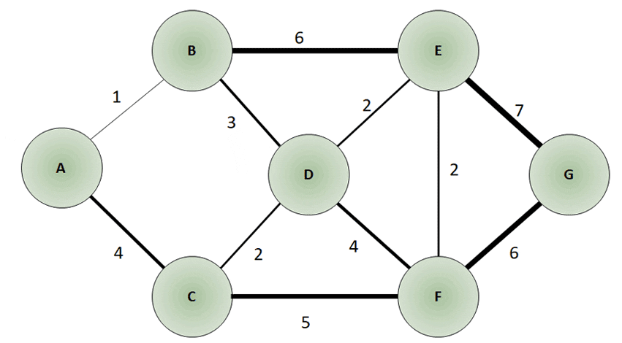
Non-Primitive Data Structures (Non-Linear)
7. Graph
A Graph is a non-linear data structure consisting of a set of nodes (also called vertices) connected by edges. A graph is a way to represent relationships or connections between entities.
Notes:
Types of Graphs
Based on Direction:
Undirected Graph: Edges have no direction → (A — B)
Directed Graph (Digraph): Edges have direction → (A → B)
Based on Weight:
Unweighted Graph: All edges are equal
Weighted Graph: Each edge has a cost or weight (used in shortest-path problems)
Based on Cycles:
Cyclic Graph: Contains cycles
Acyclic Graph: No cycles (e.g., DAG – Directed Acyclic Graph)
Special Graphs:
Tree: A type of acyclic connected graph
Complete Graph: Every vertex is connected to every other
Sparse vs. Dense Graph: Based on number of edges
Algorithms: Dijkstra's, Bellman-Ford algorithms
Applications of Graphs
Field Application Example
Social Networks Facebook, LinkedIn (users as nodes, friendships as edges)
Web Search Google PageRank (webpages as graph)
Navigation GPS Routing (roads as weighted graphs)
Compilers Dependency graphs for task scheduling
Network Routing Internet routing, packet delivery
Biology Gene/protein interaction networks
AI/Game Dev Pathfinding (A* algorithm)
Advantages of Graphs
Represent complex relationships naturally
Can model both symmetric and asymmetric relationships
Enable powerful algorithms for optimization and discovery
Disadvantages
Can require significant memory (especially adjacency matrix)
Graph algorithms can be computationally intensive
Representing large-scale graphs needs careful storage design

Slide 43
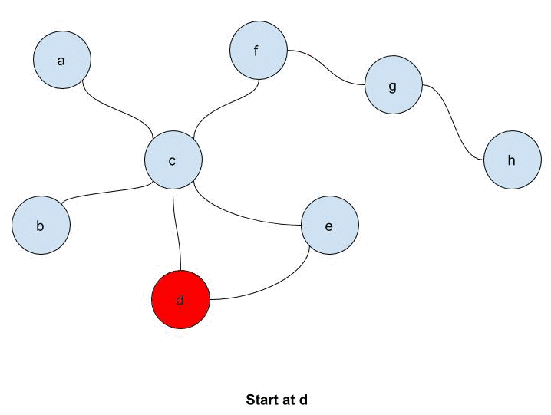
Non-Primitive Data Structures (Non-Linear)
7. Graph
A graph is a mathematical structure used to model pairwise relationships between objects.
It consists of:
Nodes (Vertices): Represent entities (e.g., web pages in PageRank).
Edges: Represent connections or relationships between nodes (e.g., hyperlinks between web pages).

Slide 44

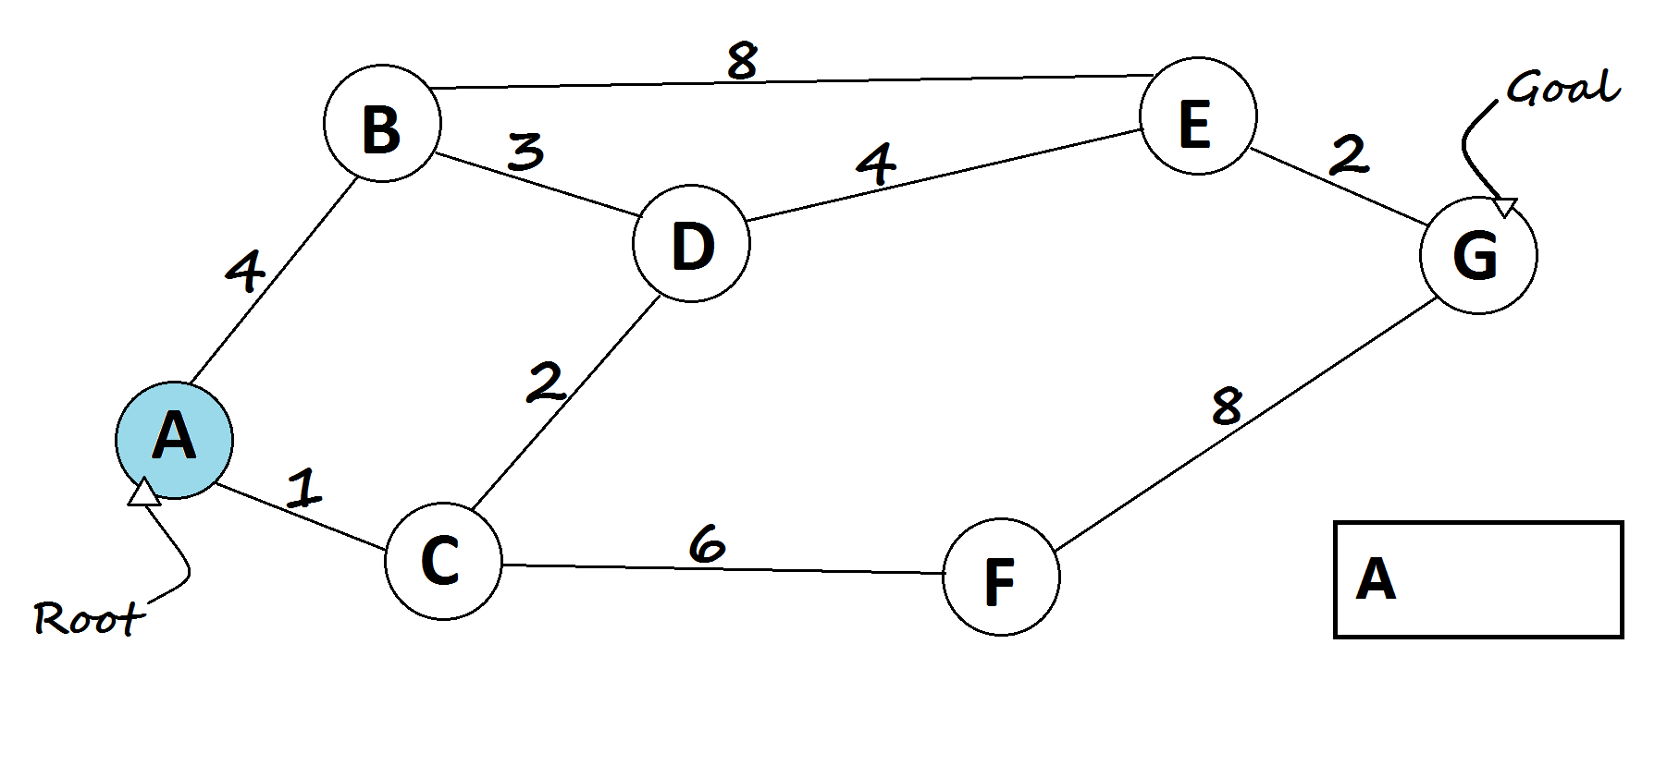
Non-Primitive Data Structures (Non-Linear)
7. Graph
Path: A sequence of nodes connected by edges. Example: A -> G is a path
Cycle: A path where the start and end nodes are the same.

Slide 45
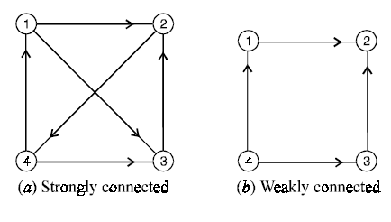
Non-Primitive Data Structures (Non-Linear)
7. Graph (Types)
i. Connectivity
Strongly Connected Graph: Every node is reachable from every other node.
Weakly Connected Graph: Nodes are connected, but directions of edges may not allow traversal.

Slide 46
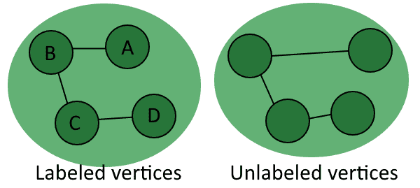
Non-Primitive Data Structures (Non-Linear)
7. Graph (Types)
ii. Unlabeled and Labeled Graphs
Unlabeled Graphs:
A graph where nodes and edges are not assigned any labels; only the structure (connections) matters.
Labeled Graphs:
A graph where nodes (vertices) and/or edges are assigned specific labels (names, numbers, or symbols) to provide additional information.

Slide 47
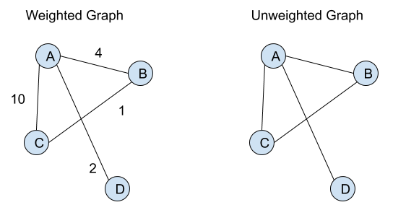
Non-Primitive Data Structures (Non-Linear)
7. Graph (Types)
iii. Weighted vs. Unweighted Graphs
Weighted Graph:
Edges have weights (numerical values) indicating their strength or importance.
A web page’s link may have a weight based on the frequency of clicks.
Unweighted Graph:
All edges have equal importance.
Friendship connections.

Slide 48
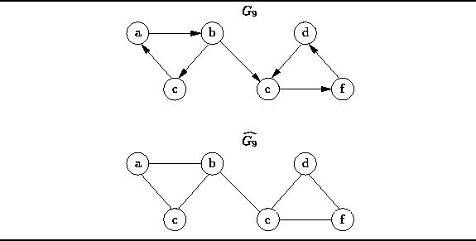

Non-Primitive Data Structures (Non-Linear)
7. Graph (Types)
iv. Directed and Undirected Graph
Directed Graph (Digraph):
Edges have a specific direction (arrows).
The web, where a hyperlink points from one page to another.
Undirected Graph:
Edges have no direction.
A social network where a connection is mutual.

Slide 49
Example Weighted Graph
We have a small network of 4 nodes: A, B, C, D
The “weight” represents the cost, distance, or time between two connected nodes.
Goal: Find the Shortest Path from A → D
We’ll calculate the minimum total weight using the shortest path.
2
B
Edge | Weight
A → B | 2
A → C | 4
B → C | 1
B → D | 7
C → D | 3
A
7
1
4
C
D
3

Slide 50
Example Weighted Graph
2
B
Goal: Find the Shortest Path from A → D
Step-by-Step Calculation
Start at A
Distance to A = 0
Distance to all others = ∞ (infinity)
From A:
A → B = 2
A → C = 4
So: Dist(B) = 2, Dist(C) = 4
Go to B (smallest distance = 2)
From B → C = 1 → new path cost = 2 + 1 = 3 (Compare to old Dist(C)=4 → update to 3)
From B → D = 7 → new path cost = 2 + 7 = 9 (Dist(D) = 9)
Now: A=0, B=2, C=3, D=9
Next, go to C (smallest distance = 3)
From C → D = 3 → new path cost = 3 + 3 = 6 (Compare to old Dist(D)=9 → update to 6)
Now: A=0, B=2, C=3, D=6
Shortest Path from A → D = 6
A
7
1
4
C
D
3

Slide 51
Python data-structures used in AI Development

Slide 52
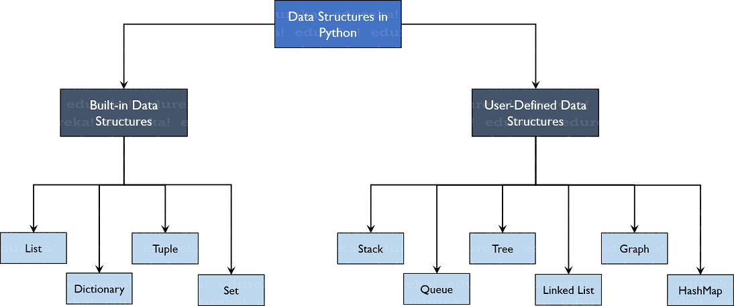
Python data-structures used in AI Development

Slide 53
1. List Data-structure (Python)
A List in Python is a built-in data structure used to store multiple items in a single variable.
It is ordered, mutable (changeable), and allows duplicate values. A List is written using square brackets [ ], and items are separated by commas.
Key Features:
Ordered: Items have a defined order (index starts from 0). Example: fruits[0] → "apple"
Mutable: You can change, add, or remove elements. Example: fruits[1] = "mango"
Allows Duplicates: Lists can have repeated elements. Example: [1, 2, 2, 3]
Can store mixed data types: Example: [1, "Hello", 3.14, True]

Slide 54
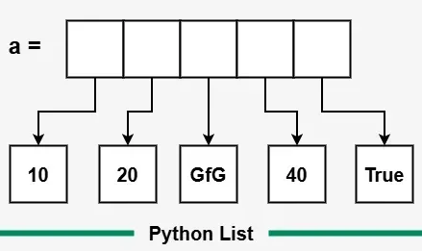
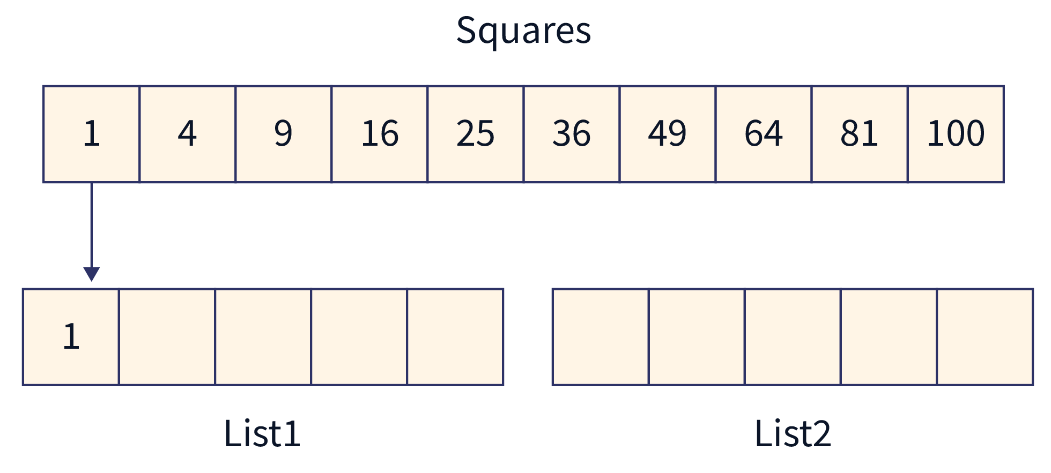
1. List Data-structure (Python)
A list can contain different data types: int, float, string:
list1 = [“abc”, 34, True, 40, ”male”]

Slide 55
2. Tuples Data-structure (Python)
A Tuple in Python is a collection of ordered items, just like a list — but it is immutable, meaning once created, you cannot change, add, or remove elements from it.
It’s often used when you want to store data that should not change throughout the program.
A Tuple is written using parentheses ( ), and items are separated by commas.
Key Features:
Ordered: Elements have a fixed order (index starts from 0).
Immutable: You cannot modify a tuple after creation.
Allows Duplicates: Just like lists, tuples can contain repeated values.
Can store mixed data types: Example: (1, "Hello", 3.14, True)

Slide 56
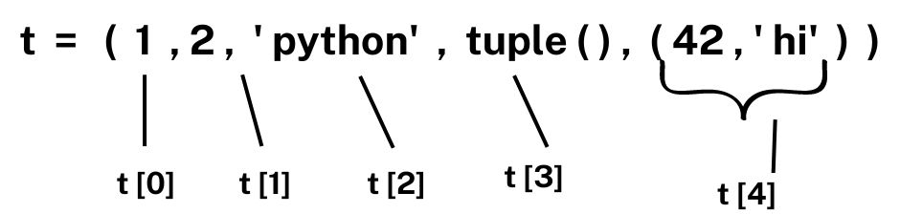
2. Tuples Data-structure (Python)
A tuple can contain different data types: with strings, integers and boolean
tuple1 = ("abc", 34, True, 40, "male")
student = ("Ali", 22, "Computer Science")
print(student[0]) # Output: Ali
print(len(student)) # Output: 3

Slide 57
3. Set Data-structure (Python)
A Set in Python is an unordered collection of unique elements. It means that:
It does not allow duplicates.
The order of elements is not fixed.
It is very useful for mathematical operations like union, intersection, and difference.
A Set is written using curly braces { }, and items are separated by commas.
Key Features:
No Duplicates: Each element appears only once.
Unordered: The order of items may change each time you print the set.
Mutable: You can add or remove items, but the elements inside must be immutable (e.g., numbers, strings, tuples).
No Indexing: You cannot access elements by index like lists or tuples.

Slide 58
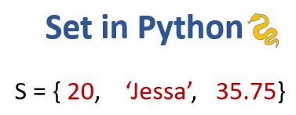
3. Set Data-structure (Python)
A set can contain different data types: with strings, integers and boolean
set1 = {"abc", 34, True, 40, "male"}
A = {1, 2, 3, 4}
B = {3, 4, 5, 6}
print(A | B) # Union → {1, 2, 3, 4, 5, 6}
print(A & B) # Intersection → {3, 4}
print(A - B) # Difference → {1, 2}
print(A ^ B) # Symmetric Difference → {1, 2, 5, 6}

Slide 59
4. Dictionary Data-structure (Python)
A Dictionary in Python is an unordered collection of key–value pairs. It’s like a real-world dictionary, you look up a word (key) to get its meaning (value).
A dictionary is created using curly braces { }, with keys and values separated by a colon :.
Key Features:
Key–Value Mapping: Each key is unique and maps to a specific value.
Unordered: The order of items may vary (though Python 3.7+ keeps insertion order).
Mutable: You can change, add, or remove key-value pairs.
Unique Keys: No two keys can be the same.
Fast Lookups: Searching by key is very fast (hash-based structure).

Slide 60
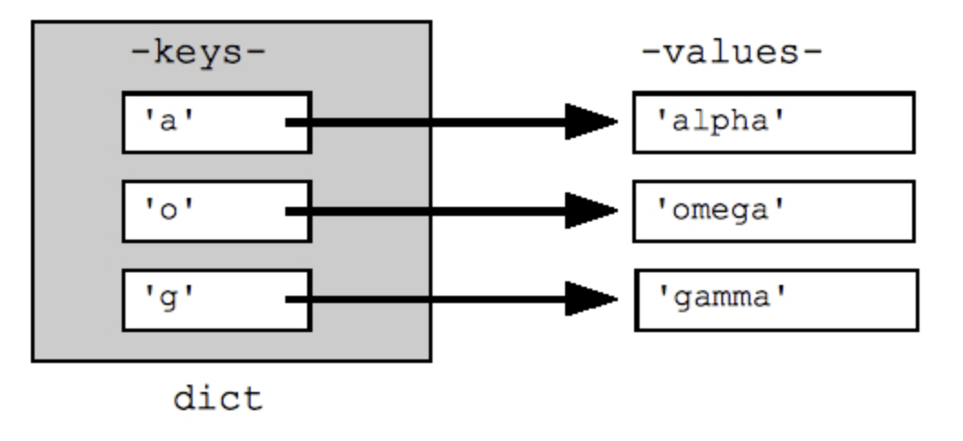
4. Dictionary Data-structure (Python)
The values in dictionary items can be of any data type. Using the dict() method to make a dictionary. thisdict = dict(name = "John", age = 36, country = "Norway")
person = {"name": "Mubashir", "country": "Pakistan", "profession": "Engineer"}
print(person["name"]) # Access value → Mubashir
person["age"] = 33 # Add new key-value pair
person["profession"] = "AI Expert" # Update value
del person["country"] # Remove key-value pair
print(person)

Slide 61

Not included in Syllabus
If you were taking a nap, wake up… the lecture is over!

Slide 62

Recap
Primitive Data Structures
Int, Float / Double, Char, Bool
Non primitive Data Structures
Array, Linked List, Stack, Queue, Hash Table
Tree
Binary Tree, Binary Search Tree (BST), Balanced Binary Tree, AVL Tree, Heap Tree, Trie
Graph
Strong, Labeled, Directed, Weighted,
Some python language Data Structures, important for data preprocessing
List, Tuples, Set, Dictionary

